Slide 1
Mental Health Diversion
by Jess Rodriguez
Assistant District Attorney
Orange County District Attorney’s Office
Recidivism Reduction Unit

Slide 2
TABLE OF CONTENTS
PART ONE:
BEFORE THE HEARING
How Did We Get Here?
Who Is Eligible?
What Are the Requirements?
How to File?
PART TWO:
HEARING AND BEYOND
How Do Hearings Work?
What If It’s Denied?
What If It’s Granted?
How Does It End?

Slide 3
1. How We Got Here

Slide 4
2018
Assembly Bill 1810
Stated goal: create an option of pre-trial mental health diversion for defendants who met certain criteria
Signed by the Governor in June 2018
Becomes Penal Code 1001.36

Slide 5
OCDA Response Under DA Spitzer
March 2019 – RRU created
August 2019 – Mental Health Division of RRU begins

Slide 6
2. Who Is Eligible?

Slide 7
MENTAL HEALTH DIVERSION ELIGIBILITY
Eligible
Everything Else
Ineligible
Murder
Voluntary Manslaughter
All 290 charges except 314
PC 11418 (weapons of mass destruction)

Slide 8
3. What Are the Requirements?

Slide 9
Six Requirements for MHD Eligibility
1. Qualifying disorder
2. Nexus between disorder and crime
1
2
3. Symptoms will respond to treatment
6
3
4. Consent to diversion
5
4
5. Consent to treatment
6. Not an “unreasonable risk”

Slide 10
ABOUT THOSE REQUIREMENTS…
All 6 must be met for Defendant to be eligible
Defense burden, not the prosecution
1
2
6
3
5
4

Slide 11
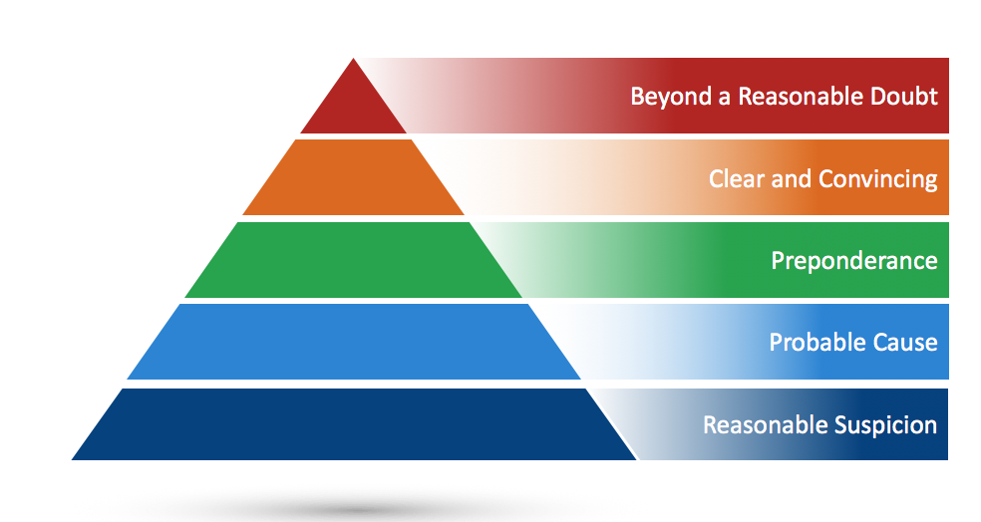
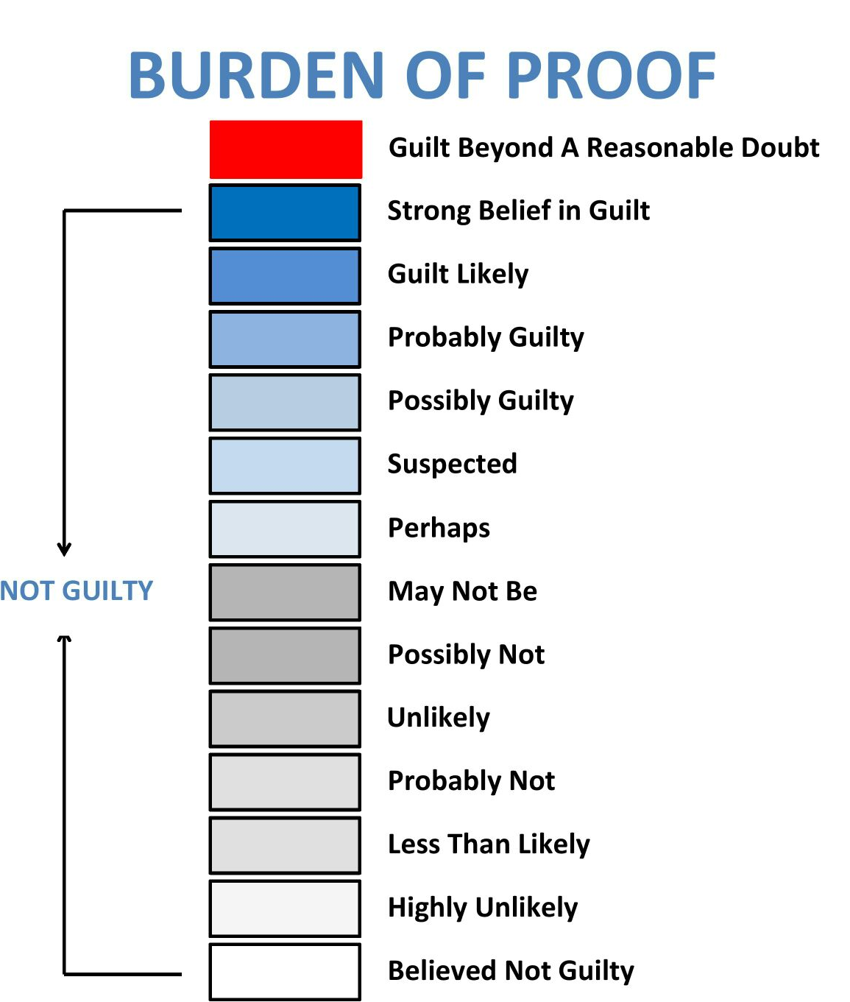
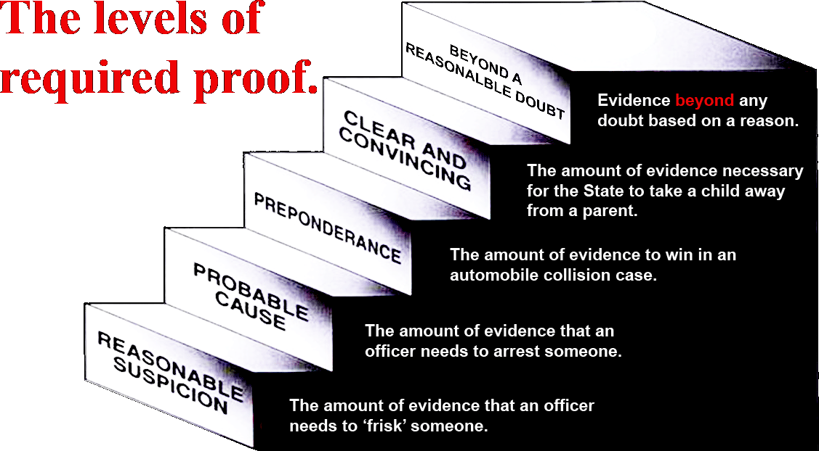
STANDARD OF PROOF?
“Satisfaction of the court”
Even if all requirements met, it’s still a discretionary call

Slide 12
KEEP IN MIND…
There is no such thing as Orange County’s Mental Health Diversion “Program” or “Court.”

Slide 13
1. DEFENDANT HAS A QUALIFYING DISORDER
Disorder must be recognized by DSM – easier to list what what does not qualify
Antisocial personality disorder
Borderline personality disorder
Pedophilia
Must have a recent diagnosis by a qualified mental health expert

Slide 14
“Recent diagnosis by qualified mental health expert”
“Recent” and “qualified” left up to the “satisfaction of the court”
Usually an argument over weight, not admissibility

Slide 15
2. NEXUS BETWEEN THE DISORDER AND THE CRIME
“significant factor in the commission of the charged offense”
Applies to each charge/case

Slide 16
3. SYMPTOMS OF THE DISORDER WOULD RESPOND TO TREATMENT
Symptoms, not the disorder itself
Need an expert opinion
What Treatment?

Slide 17
4. DEFENDANT CONSENTS TO DIVERSION
Diversion cannot be imposed on a defendant, even by his/her own attorney
Consent includes waiving speedy trial rights

Slide 18
5. DEFENDANT CONSENTS TO TREATMENT
What Treatment?

Slide 19
6. DEFENDANT IS NOT AN UNREASONABLE RISK
“Unreasonable risk of danger to public safety if treated in the community”
“As defined in PC 1170.18”
Super-strikes
RAP and Current Charges are important, but not the only consideration

Slide 20
4. How to File
Or at least, how to file during a pandemic

Slide 21
Current COVID Process
Pre-PH Felonies and Misdemeanors:
Each courthouse and each branch DA’s office has an email address set up for receiving these motions
Post-PH Felonies
Email motion to:
CovidMotions@occourts.org
AND
appellate@da.ocgov.com

Slide 22
OCDA Response
Pre-PH Felonies and Misdemeanors:
Most felonies handled by RRU
Misdemeanors handled by misdemeanor DDAs
Post-PH Felonies
Currently handled by Felony Panel or vertical DDAs

Slide 23
5. How Do Hearings Work?

Slide 24
THINGS TO CONSIDER
Pre-Hearing Plan?
Some judges require it, others do not.
Even if not required, should you do it anyway?
Live or Paper?
“Satisfaction of the court” means it may be worth checking with the court in advance.
Even if not required, what are the pros and cons to each?
If Live, Who?
Presumably you’ll want to call the doctor who wrote the report.
If you have a proposed plan already, what about the treatment provider?

Slide 25
OTHER CONSIDERATIONS
Marsy’s Law
Format of Hearing
Informal
May use offers of proof and reliable hearsay

Slide 26
6. What If It’s Denied?

Slide 27
WHAT LEVEL OF SUPERVISION?
Mental Health Diversion
Collaborative Courts
In-Custody Services

Slide 28
MH Diversion vs. Collab. Courts
No plea required | Plea required
No probation officer assigned | Probation Officer Assigned
??? | Court “team” assigned
Proof of nexus required | Nexus may not be required
??? | Clear phases/incentives/sanctions
Charges dismissed if successful | Charges dismissed if successful

Slide 29
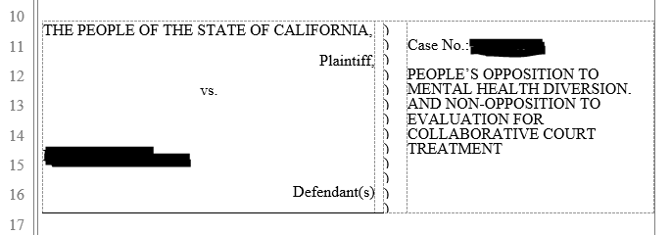
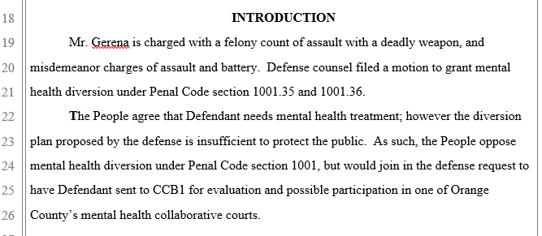

Slide 30
MH Diversion Motions that were Denied or Withdrawn, but subsequently referred to Collaborative Courts

Slide 31
7. What If It’s Granted?

Slide 32
AFTER DIVERSION GRANTED
Series of progress reviews
Treatment provider must provide regular reports to the court, defense, and prosecution
“Satisfaction of the court”

Slide 33
WHAT ABOUT RESTITUTION?
Court shall hold restitution hearing upon request
If any is owed, court can order its payment during the diversion period
Inability to pay cannot be used as reason to deny diversion or find failure to comply

Slide 34
8. How Does It End?

Slide 35
WHEN DOES DIVERSION END?
No set time for diversion program
No minimum, 2 yr maximum for proceedings

Slide 36
If Defendant “Performs Satisfactorily”:
Charges dismissed, end of case
Arrest deemed never to have occurred
“Performs satisfactorily”
Substantial compliance
No “significant” new law violations
Has a long-term mental health care plan

Slide 37
THE OTHER WAY TO END DIVERSION - TERMINATION
Withdrawal from program
Non-compliance with program
New crime committed
Not automatic termination

Slide 38
New Crime During Diversion
Court shall hold a hearing if new crime is:
Any felony
Misdemeanor reflecting propensity for violence
“engaged in criminal conduct rendering the defendant unsuitable”

Slide 39
Some Questions to Ask Before Starting
What level of supervision will give my client the best chance to succeed?
Do I have a program in mind already?
Who should I reach out to?

Slide 40
THANKS!
Any questions?
jess.rodriguez@da.ocgov.com

